Slide 1
Sensor Fusion Toolbox for Rocket Motion
Luke Aagaard, Kian Jamal, Nathan Tardy, 4/11/2024

Slide 2
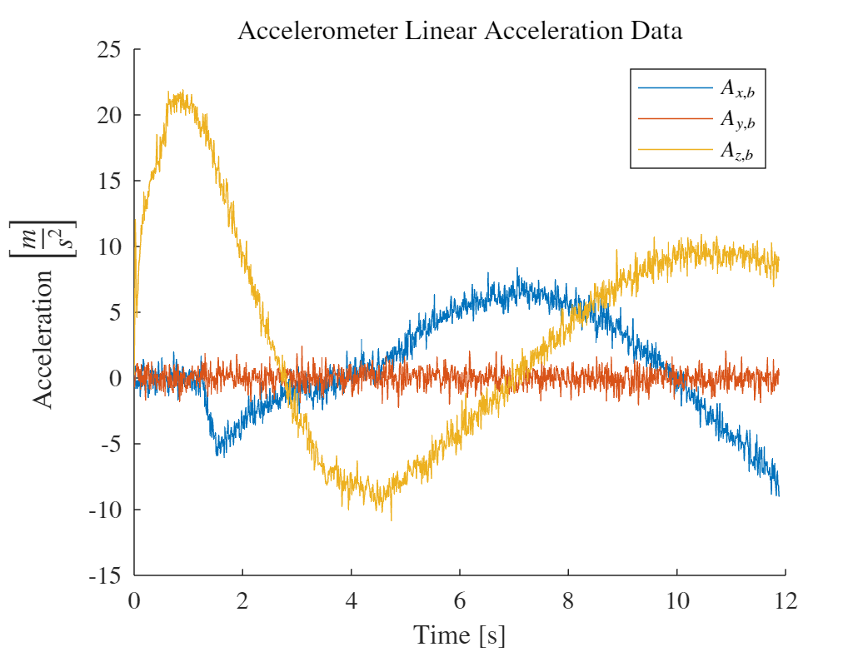
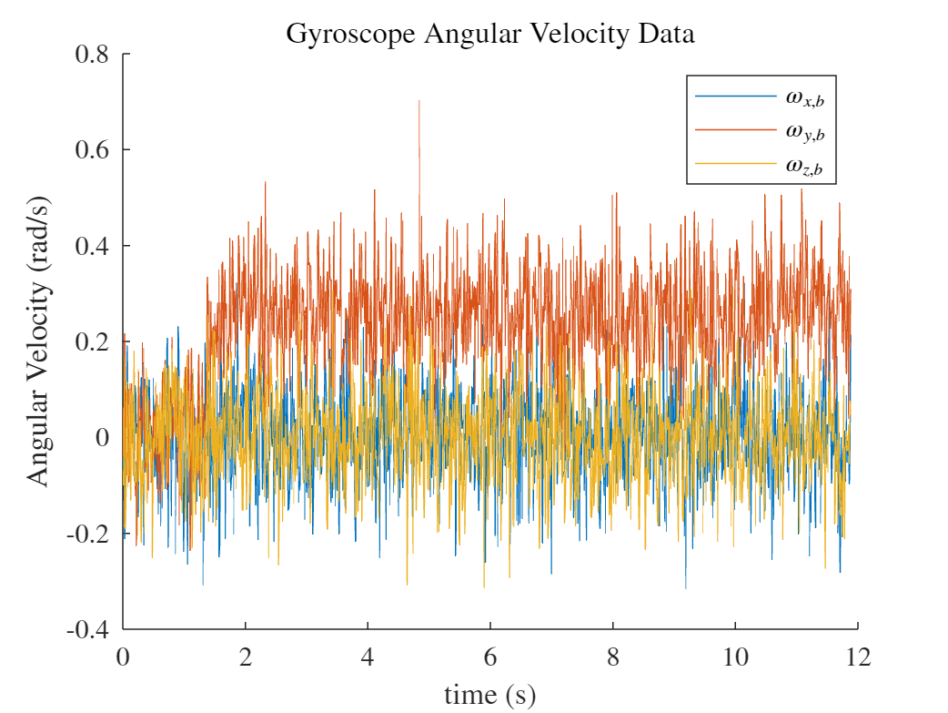
Data Processing
Angular velocity along body axes
Input: raw (noisy) data from virtual sensors
Only really 1 non-zero component due to nature of the motion
No yaw
No roll
Linear acceleration along body axes
4/9/2024
Nathan Tardy
2

Slide 3
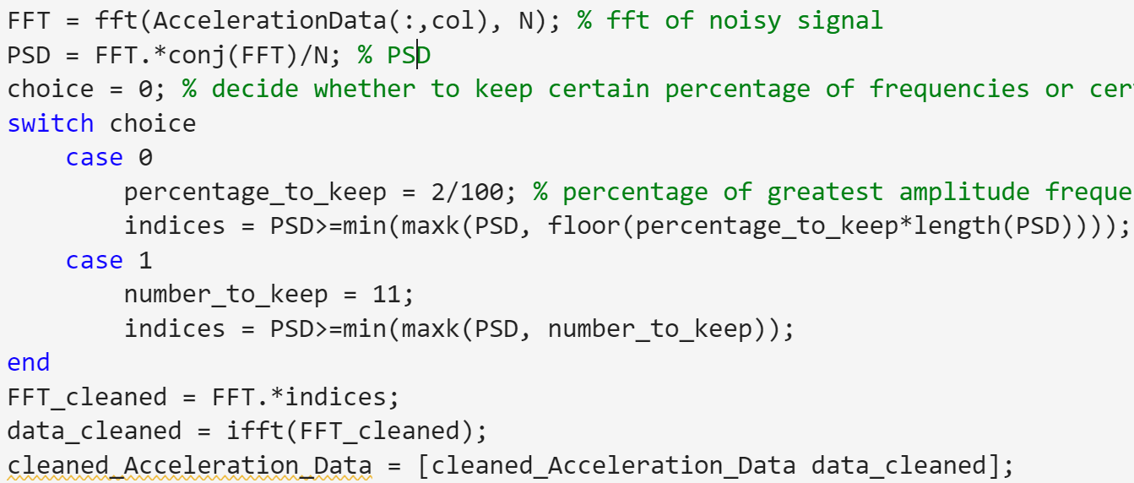
Data Processing
Method: FFT on noisy data (HW 4)
4/9/2024
Nathan Tardy
3

Slide 4
Data Processing
Method: FFT on noisy data (HW 4)
4/9/2024
Nathan Tardy
4

